Slide 1

ID2203 - Tutorial 1
Distributed Systems, Advanced Course
Cosmin Arad icarad @ kth.se
Tallat Shafaat tallat @ kth.se
Seif Haridi haridi @ kth.se
KTH – The Royal Institute of Technology

Slide 2
Overview
Introduction to Kompics
Relation to the textbook
Assignments framework
First assignment
Cosmin Arad, icarad @ kth.se

Slide 3

Kompics introduction
Component Model for Distributed Systems
Cosmin Arad, icarad @ kth.se

Slide 4
We want to build distributed systems
Cosmin Arad, icarad @ kth.se

Slide 5
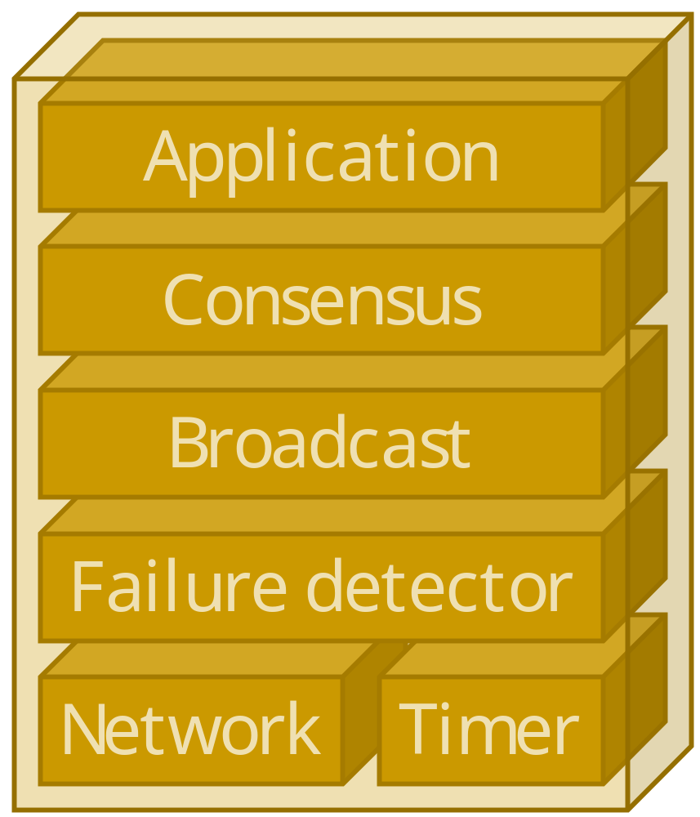
by composing distributed protocols
Cosmin Arad, icarad @ kth.se

Slide 6
Implemented as reactive components
Cosmin Arad, icarad @ kth.se

Slide 7
with message-passing concurrency
Application
Consensus
Broadcast
Failure detector
Network
Timer
Cosmin Arad, icarad @ kth.se

Slide 8
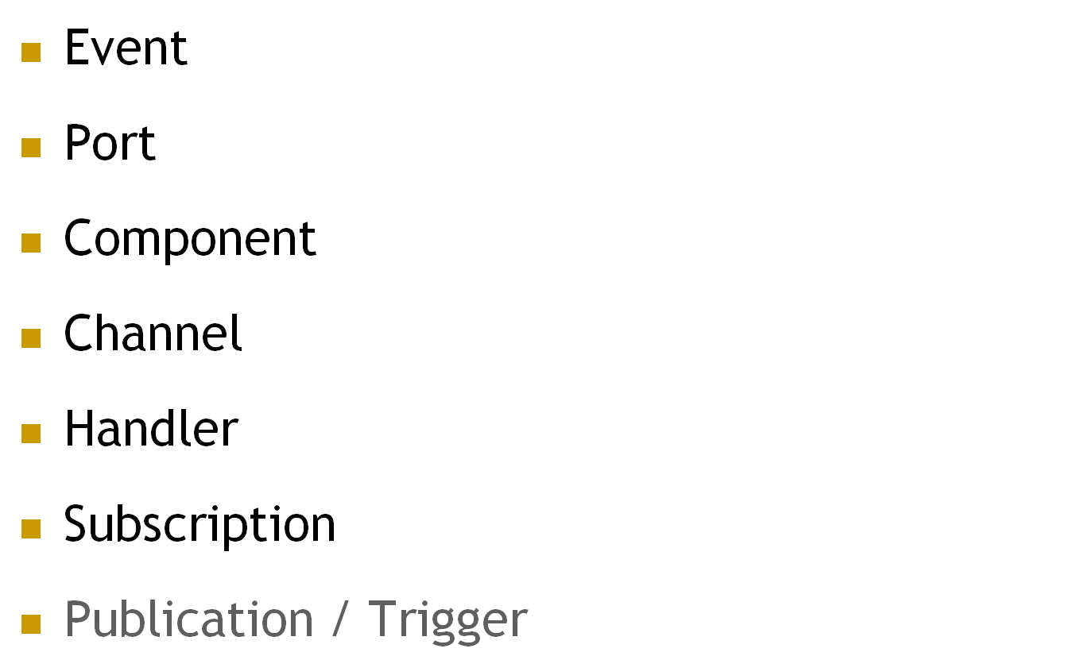
Concepts in Kompics
Event
Port
Component
channel
handler
Cosmin Arad, icarad @ kth.se

Slide 9
Events
Event
Events are passive immutable objects
  with typed attributes / fields
Events are typed and can be sub-typed
class Message extends Event {
Address source;
Address destination;
}
class DataMessage extends Message {
Data data;
int sequenceNumber;
}
Message
DataMessage
DataMessage ⊆ Message
Cosmin Arad, icarad @ kth.se

Slide 10
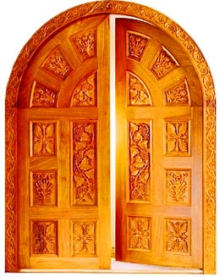






Ports
Port
Direction
Direction
Cosmin Arad, icarad @ kth.se

Slide 11
Ports
Port
are bidirectional event-based comp interfaces
  have a positive (+) and a negative (−) direction
A port type consists of 2 sets of event types
  one set of event types for each direction, + and −
  represents a service/protocol abstraction
+
−
+
−
Network
class Network extends PortType {{
positive(Message.class);
negative(Message.class);
}}
class Timer extends PortType {{
positive(Timeout.class);
negative(ScheduleTimeout.class);
negative(CancelTimeout.class);
}}
Network
+
−
Message
Message
+
−
+
−
Timer
Timer
+
−
Timeout
ScheduleTimeout
CancelTimeout
Cosmin Arad, icarad @ kth.se

Slide 12
Components with Ports Example
The Failure Detector component could use the Network and Timer components
Requires / uses a Network service
Provides / implements a Failure Detector service
Requires / uses a Timer service
+
−
Failure Detector
Provides / implements a Network service
Provides / implements a Timer service
Failure Detector
Component
Message
ScheduleTimeout
+
−
Network
+
−
Timer
Message
ScheduleTimeout
+
−
Message
+
−
Network
+
−
Timer
Network
Component
Timer
Component
Message
Message
Message
Timeout
Timeout
+
−
Timeout
ScheduleTimeout
CancelTimeout
Cosmin Arad, icarad @ kth.se

Slide 13
Channels
channel
+
−
Failure Detector
Channels connect complementary ports of the same type
  + to −
  − to +
Channels forward events in FIFO order in both directions
Failure Detector
Component
+
−
Network
+
−
Timer
channel₁
channel₂
+
−
Network
+
−
Timer
Network
Component
Timer
Component
Cosmin Arad, icarad @ kth.se

Slide 14
Event handlers
handler
A handler is a first-class component procedure
accepting a particular type of events
executed reactively upon receiving an event
  may mutate the local state and trigger new events
  handlers of one component are mutually exclusive
Handler<DataMessage> handleData = new Handler<DataMessage>() {
public void handle(DataMessage dm) {
messages++; // component state update
trigger(new MessageReceived(dm.data), somePort);
trigger(new AckMessage(myAddress, dm.source, dm.sequenceNumber), network); // event triggering
}
};
Cosmin Arad, icarad @ kth.se

Slide 15
Subscriptions & Publications
A subscription binds an event handler, h, to a local component port p
Let e be the type of h
  let f be a supertype of e
  f must come in on p
After subscription
  h will handle all events of any type d, subtype of e, coming in on p
+
−
SomePort
…
messages
…
=2
++
=3
MessageReceived
handleData
<DataMessage>
MessageReceived
AckMessage
AckMessage
DataMessage
+
−
Network
DataMessage
Cosmin Arad, icarad @ kth.se

Slide 16
Components
Component
are instantiated from component definitions
  component definitions are Java classes
A component instance is an object containing
  local state variables
  ports (provided or required interfaces)
  event handlers
  subscriptions
  encapsulated subcomponents
  channels
form a containment hierarchy rooted at Main
Cosmin Arad, icarad @ kth.se

Slide 17
Hello World! Example
Main
Component 1
Start
start
handler₁
<World>
Hello
+
−
World
required port
Hello
provided port
+
−
World
Component 2
Hello
handler₂
<Hello>
World
Cosmin Arad, icarad @ kth.se

Slide 18

Control port
Every component has a Control port
  by default (provided)
  not shown in diagrams
  allows component to handle lifecycle events
Exceptions / faults not caught inside a handler
  wrapped into Fault event
  triggered on control port
+
−
Control
Component
Start
Stop
Init
someHandler
Fault
Fault
+
−
Control
+
−
Fault
Start
Stop
Init
Cosmin Arad, icarad @ kth.se

Slide 19
Hello World! Example
Main
Component 1
Hello
start
handler₁
<World>
World
+
−
World
Hello
+
−
World
+
−
HelloWorld
Component 2
Hello
+
−
World
Hello
handler₂
<Hello>
Cosmin Arad, icarad @ kth.se

Slide 20
Source code: Events and Port
public final class Hello extends Event {
private final String message;
public Hello(String m) {
message = m;
}
public String getMessage() {
return message;
}
}
public final class World extends Event {
}
public class HelloWorld extends PortType{{
positive(World.class);
negative(Hello.class);
}}
Hello
World
+
−
HelloWorld
+
−
World
Hello
Cosmin Arad, icarad @ kth.se

Slide 21
Source code: Component1
public class Component1 extends ComponentDefinition {
private Positive<HelloWorld> hwPort = positive(HelloWorld.class);
public Component1() {
System.out.println("Component1 created.");
subscribe(startHandler, control);
subscribe(worldHandler, hwPort);
}
Handler<Start> startHandler = new Handler<Start>() {
public void handle(Start event) {
System.out.println("Component1 started. Triggering Hello...");
trigger(new Hello("Hi there!"), hwPort);
}};
Handler<World> worldHandler = new Handler<World>() {
public void handle(World event) {
System.out.println("Component1 received World event.");
}};
}
Component1
start
handler₁
<World>
+
−
HelloWorld
Cosmin Arad, icarad @ kth.se

Slide 22
Source code: Component2
public class Component2 extends ComponentDefinition {
private Negative<HelloWorld> hwPort = negative(HelloWorld.class);
public Component2() {
System.out.println("Component2 created.");
subscribe(startHandler, control);
subscribe(helloHandler, hwPort);
}
Handler<Start> startHandler = new Handler<Start>() {
public void handle(Start event) {
System.out.println("Component2 started.");
}};
Handler<Hello> helloHandler = new Handler<Hello>() {
public void handle(Hello event) {
System.out.println("Component2 received Hello event with "
+ "message: " + event.getMessage());
trigger(new World(), hwPort);
}};
}
+
−
HelloWorld
Component 2
handler₂
<Hello>
Cosmin Arad, icarad @ kth.se

Slide 23
Source code: Main
Main
Component 1
+
−
HelloWorld
Main is a Java main class
+
−
HelloWorld
Component 2
public class Main extends ComponentDefinition {
private Component component1, component2;
public Main() {
System.out.println("Main created.");
component1 = create(Component1.class);
component2 = create(Component2.class);
connect(component1.getNegative(HelloWorld.class),
component2.getPositive(HelloWorld.class));
}
public static void main(String[] args) {
Kompics.createAndStart(Main.class);
Kompics.shutdown();
}
}
Cosmin Arad, icarad @ kth.se

Slide 24
Output
prompt:$ java Main
Main created.
Component1 created.
Component2 created.
Component1 started. Triggering Hello...
Component2 started.
Component2 received Hello event with message: Hi there!
Component1 received World event.
prompt:$ _
Kompics runtime creates and starts Main
  Main recursively creates and starts c1, c2
  c1’s start handler triggers Hello event
    handled by c2, which triggers World event
      handled by c1
Cosmin Arad, icarad @ kth.se

Slide 25
Scheduling / Canceling a Timeout
MyTimeout ⊆ Timeout
class MyComponent extends ComponentDefinition {
Positive<Timer> timer = positive(Timer.class); //required
{
// scheduling a timeout
long delay = 5000;
ScheduleTimeout st = new ScheduleTimeout(delay);
st.setTimeoutEvent(new MyTimeout(st));
UUID timeoutId = st.getTimeoutEvent().getTimeoutId();
trigger(st, timer);
// canceling a timeout
CancelTimeout ct = new CancelTimeout(timeoutId);
trigger(ct, timer);
}
}
Cosmin Arad, icarad @ kth.se

Slide 26
Publish / Subscribe
Component 1
Component 2
handler₁
<MessageA>
handler₂
<MessageB>
+
−
Network
+
−
Message
+
−
Network
+
−
Network
Message
MessageA ⊆ Message
MessageB ⊆ Message
channel₁
channel₂
MessageA ⊄ MessageB
+
−
Network
MessageB ⊄ MessageA
Network
Component
MessageB
MessageA
Cosmin Arad, icarad @ kth.se

Slide 27
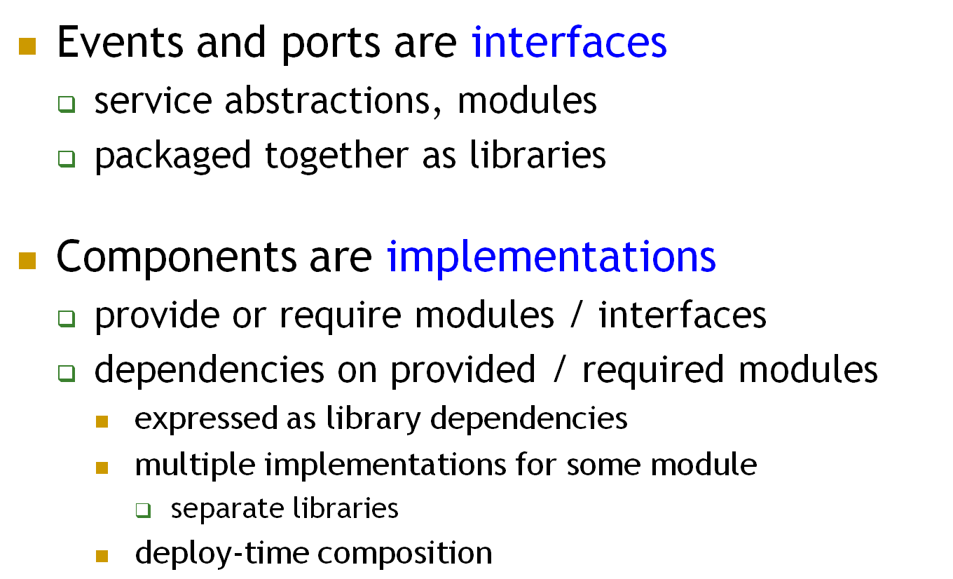
Software engineering view
Cosmin Arad, icarad @ kth.se

Slide 28
Relation to the textbook
How we use Kompics to model the abstractions in the textbook / course
Cosmin Arad, icarad @ kth.se

Slide 29
Modules – ports, with examples
Algorithms – components
Events are the same
Introduce Pp2p, Flp2p, Timer.
  To be updated shortly…
Cosmin Arad, icarad @ kth.se

Slide 30
Assignments framework
How we run distributed systems and create experiment scenarios
Cosmin Arad, icarad @ kth.se

Slide 31
Topology – description, code
Scenario – description, code
Assignment0 - description
DelayLink enforces delays
DelayDropLink enforces delays and drops
Application enforces a script of requests
Together used to design execution scenarios
Launcher description; window, kill, input/all
  To be updated shortly…
Cosmin Arad, icarad @ kth.se

Slide 32
To terminate an experiment type
Ctrl+K

Slide 33
First assignment
Failure detectors
Cosmin Arad, icarad @ kth.se

Slide 34
Architectures
Ports / events
Algorithms
  To be updated shortly…
Cosmin Arad, icarad @ kth.se

Slide 35
Good luck!
Cosmin Arad, icarad @ kth.se

